Slide 1
Expert System
Note: Some slides and/or pictures are adapted from Lecture slides / Books of
Dr Zafar Alvi.
Text Book - Aritificial Intelligence Illuminated by Ben Coppin, Narosa Publishers.
Ref Books
Artificial Intelligence- Structures & Strategies for Complex Problem Solving by George F. Luger, 4th edition, Pearson Education.
Artificial Intelligence A Modern Approach by Stuart Russell & Peter Norvig.
Artificial Intelligence, Third Edition by Patrick Henry Winston

Slide 2
What is an Expert?
They possess specialized knowledge in a certain area.
They possess experience in the given area.
They can provide an explanation of their decisions.
They have a skill set that enables them to translate the specialized knowledge gained through experience into solutions.

Slide 3
What is an expert system?
According to Durkin, an expert system is “A computer program designed to model the problem solving ability of a human expert”.
Expert system contains two things
Knowledge
Reasoning

Slide 4
History and Evolution
Dendral (1960’s)
MYCIN (mid 70s)
R1/XCON (late 70’s)

Slide 5
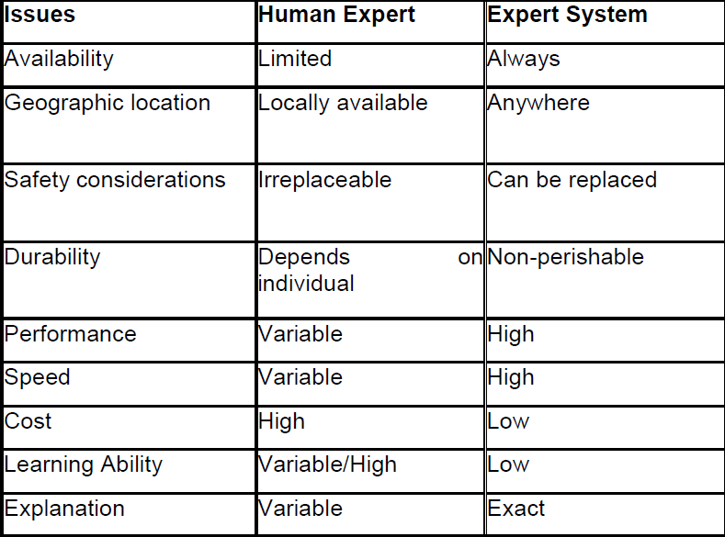
Comparison of a human expert and an expert system

Slide 6
Roles of an expert system
An expert system may take two main roles, relative to the human expert. It may replace the expert or assist the expert
Replacement of expert
It is not very practical in some situations, but feasible in others.
Consider drastic situations where safety or location is an issue, e.g. a mission to Mars.
In such cases replacement of an expert may be the only feasible option.
Also, in cases where an expert cannot be available at a particular geographical location e.g. volcanic areas, it is expedient to use an expert system as a substitute.

Slide 7
Roles of an expert system
Assisting expert
Assisting an expert is the most commonly found role of an ES.
The goal is to aid an expert in a routine tasks to increase productivity, or to aid in managing a complex situation by using an expert system that may itself draw on experience of other (possibly more than one) individuals.
Such an expert system helps an expert overcome shortcomings such as recalling relevant information.
XCON is an example of how an ES can assist an expert.

Slide 8
How are expert systems used?
Control applications (e.g. controlling a manufacturing process, or medical treatment)
Design (PEACE, which is a CAD tool to assist in design of electronic structures)
Diagnosis and Prescription (e.g. diagnosis based on patient’s symptoms, diagnosing malfunctioning electronic structures)
Instruction and Simulation (Tutoring applications include GUIDON (Clancey 1979), which instructs students in diagnosis of bacterial infections)

Slide 9
How are expert systems used?
Interpretation (According to Durkin, interpretation is ‘Producing an understanding of situation from given information’. FXAA (1988) ES provides financial assistance for a commercial bank)
Planning and prediction (e.g. recommending steps for a robot to carry out certain steps, cash management planning)

Slide 10
Expert system structure
The expert has the following:
Focused area of expertise
Specialized Knowledge (Long-term Memory, LTM)
Case facts (Short-term Memory, STM)
Reasons with these to form new knowledge
Solves the given problem

Slide 11
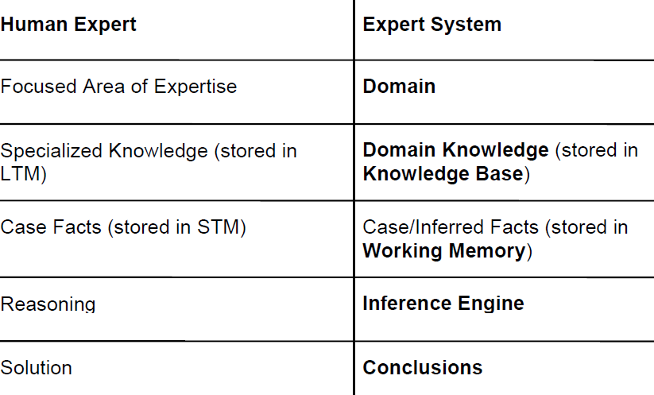

Slide 12
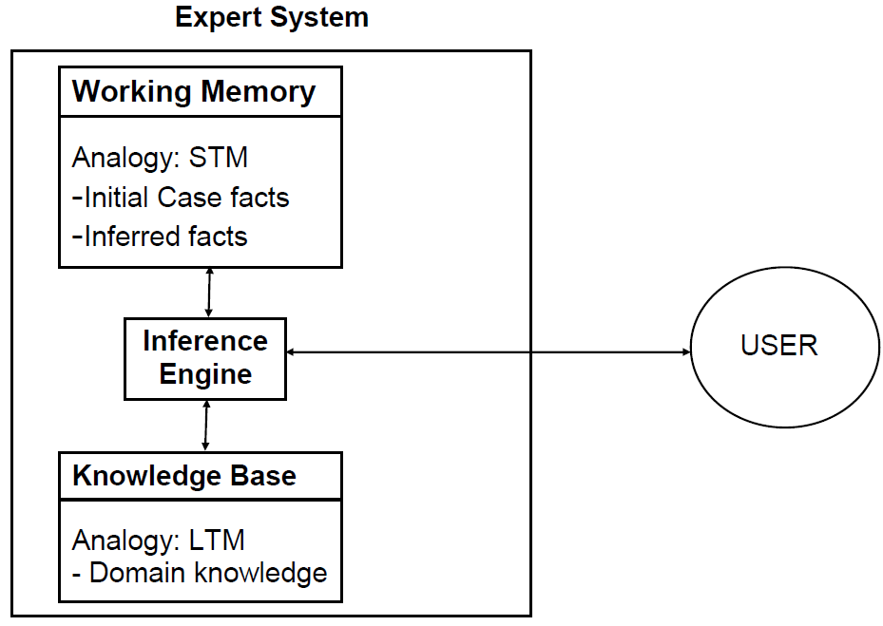
Expert system structure

Slide 13
Knowledge Base
The knowledge base is the part of an expert system that contains the domain knowledge, i.e.
Problem facts, rules
Concepts
Relationships
The power of an ES lies to a large extent in its richness of knowledge. Therefore, one of the prime roles of the expert system designer is to act as a knowledge engineer.
As a knowledge engineer, the designer must overcome the knowledge acquisition bottleneck and find an effective way to get information from the expert and encode it in the knowledge base, using one of the knowledge representation techniques.
One way of encoding that knowledge is in the form of IF-THEN rules.

Slide 14
Working memory
The working memory is the ‘part of the expert system that contains the problem facts that are discovered during the session’ according to Durkin.
One session in the working memory corresponds to one consultation. During a consultation:
User presents some facts about the situation.
These are stored in the working memory.
Using these and the knowledge stored in the knowledge base, new information is inferred and also added to the working memory

Slide 15
Inference Engine
The inference engine can be viewed as the processor in an expert system that matches the facts contained in the working memory with the domain knowledge contained in the knowledge base, to draw conclusions about the problem.
It works with the knowledge base and the working memory, and draws on both to add new facts to the working memory.

Slide 16
Inference Engine
If the knowledge of an ES is represented in the form of IF-THEN rules, the Inference Engine has the following strategy:
Match given facts in working memory to the premises of the rules in the knowledge base.
If match found, ‘fire’ the conclusion of the rule, i.e. add the conclusion to the working memory.
Do this repeatedly, while new facts can be added, until you come up with the desired conclusion.

Slide 17
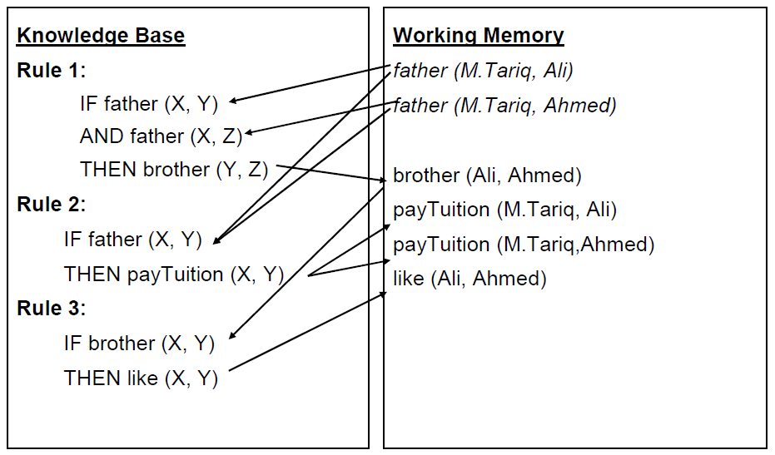
Expert System Example: Family

Slide 18
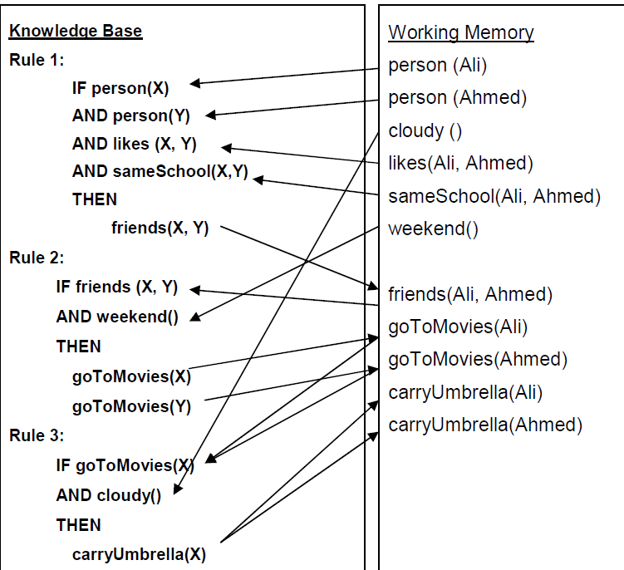
Expert system example: raining

