Slide 1
Expert System
Note: Some slides and/or pictures are adapted from Lecture slides / Books of
Dr Zafar Alvi.
Text Book - Aritificial Intelligence Illuminated by Ben Coppin, Narosa Publishers.
Ref Books
Artificial Intelligence- Structures & Strategies for Complex Problem Solving by George F. Luger, 4th edition, Pearson Education.
Artificial Intelligence A Modern Approach by Stuart Russell & Peter Norvig.
Artificial Intelligence, Third Edition by Patrick Henry Winston

Slide 2
Explanation facility
The explanation facility is a module of an expert system that allows transparency of operation, by providing an explanation of how it reached the conclusion.
In the family example above, how does the expert system draw the conclusion that Ali likes Ahmed?
The answer to this is the sequence of reasoning steps as shown with the arrows in the table below.

Slide 3
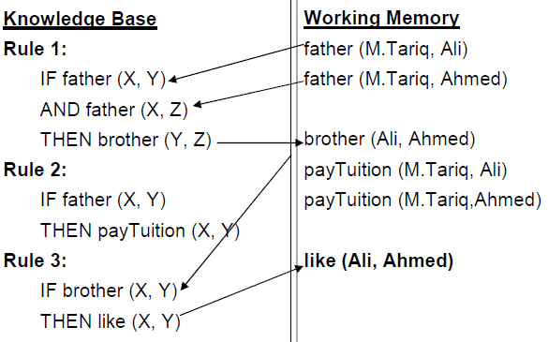

Slide 4
Characteristics of expert systems
ES have an explanation facility.
An expert system is different from conventional programs in the sense that program control and knowledge are separate. We can change one while affecting the other minimally.
”There is a clear separation of general knowledge about the problem (the rules forming the knowledge base) from information about the current problem (the input data) and methods for applying the general knowledge to a problem (the rule interpreter).The program itself is only an interpreter (or general reasoning mechanism) and ideally the system can be changed simply by adding or subtracting rules in the knowledge base” (Duda)

Slide 5
Characteristics of expert systems
An expert system also possesses expert knowledge in that it embodies expertise of human expert. It focuses expertise because the larger the domain, the more complex the expert system becomes.
ES reasons heuristically, by encoding an expert’s rules-of-thumb.
An expert system, like a human expert makes mistakes, but that is tolerable if we can get the expert system to perform at least as well as the human expert.

Slide 6
People involved in an expert system project
A domain expert is ‘A person who posses the skill and knowledge to solve a specific problem in a manner superior to others’ (Durkin).
A knowledge engineer is ‘a person who designs, builds and tests an Expert System’ (Durkin).
The end users are the people who will use the expert system.

Slide 7
Inference mechanisms
We have two formal inference mechanisms;
Forward chaining
Backward chaining

Slide 8
Forward Chaining (data driven approach)
Let’s look at how a doctor goes about diagnosing a patient. He asks the patient for symptoms and then infers diagnosis from symptoms.
Forward chaining is based on the same idea.
It is an “inference strategy that begins with a set of known facts, derives new facts using rules whose premises match the known facts, and continues this process until a goal sate is reached or until no further rules have premises that match the known or derived facts” (Durkin).

Slide 9
Approach
Add facts to working memory (WM)
Take each rule in turn and check to see if any of its premises match the facts in the WM
When matches found for all premises of a rule, place the conclusion of the rule in WM.
Repeat this process until no more facts can be added. Each repetition of the process is called a pass.

Slide 10
Doctor example (forward chaining)
Rules
Rule 1
IF The patient has deep cough
AND We suspect an infection
THEN The patient has Pneumonia
Rule 2
IF The patient’s temperature is above 100
THEN Patient has fever
Rule 3
IF The patient has been sick for over a fortnight
AND The patient has a fever
THEN We suspect an infection
Case facts
Patients temperature= 103
Patient has been sick for over a month
Patient has violent coughing fits

Slide 11
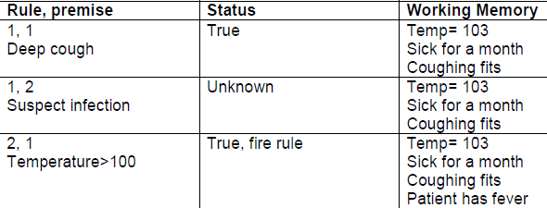
First Pass

Slide 12
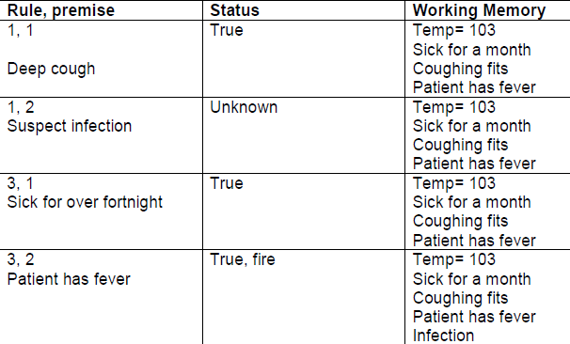
Second Pass

Slide 13
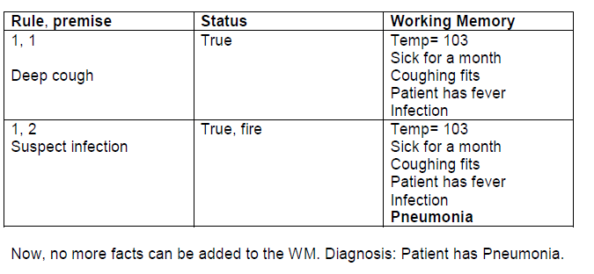
Third Pass

Slide 14
Issues in forward chaining
Undirected search
The forward chaining inference engine infers all possible facts from the given facts.
It has no way of distinguishing between important and unimportant facts.
Therefore, equal time spent on trivial evidence as well as crucial facts.

Slide 15
Issues in forward chaining
Conflict resolution
This is the question of what to do when the premises of two rules match the given facts.
Which should be fired first?
If we fire both, they may add conflicting facts, e.g.
IF you are bored
AND you have no cash
THEN go to a friend’s place
IF you are bored
AND you have a credit card
THEN go watch a movie
If both rules are fired, you will add conflicting recommendations to the working memory.

Slide 16
Conflict resolution strategies
Fire first rule in sequence (rule ordering in list).
Assign rule priorities (rule ordering by importance).
More specific rules (more premises) are preferred over general rules.
Prefer rules whose premises were added more recently to WM (timestamping).
Parallel Strategy (view-points).

Slide 17
Backward chaining
Backward chaining is an inference strategy that works backward from a hypothesis to a proof.
You begin with a hypothesis about what the situation might be.
Then you prove it using given facts, e.g. a doctor may suspect some disease and proceed by inspection of symptoms.
In backward chaining terminology, the hypothesis to prove is called the goal.

Slide 18
Approach
Start with the goal.
Goal may be in WM initially, so check and you are done if found!
If not, then search for goal in the THEN part of the rules (match conclusions, rather than premises). This type of rule is called goal rule.
Check to see if the goal rule’s premises are listed in the working memory.
Premises not listed become sub-goals to prove.
Process continues in a recursive fashion until a premise is found that is not supported by a rule, i.e. a premise is called a primitive, if it cannot be concluded by any rule.
When a primitive is found, ask user for information about it. Back track and use this information to prove sub-goals and subsequently the goal.

Slide 19
Backward chaining Doctor example
Rules
Rule 1
IF The patient has deep cough
AND We suspect an infection
THEN The patient has Pneumonia
Rule 2
IF The patient’s temperature is above 100
THEN Patient has fever
Rule 3
IF The patient has been sick for over a fortnight
AND The patient has a fever
THEN We suspect an infection
Goal
Patient has Pneumonia

Slide 20
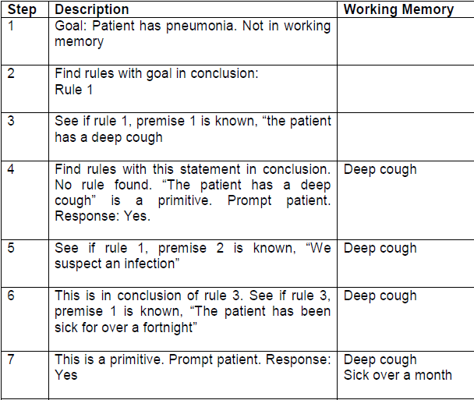

Slide 21
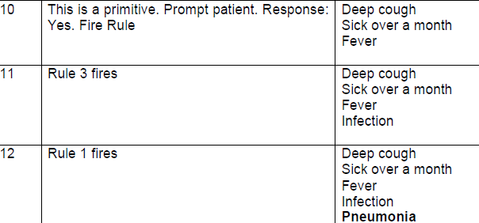

Slide 22
Forward vs. backward chaining
The exploration of knowledge has different mechanisms in forward and backward chaining.
Backward chaining is more focused and tries to avoid exploring unnecessary paths of reasoning.
Forward chaining, on the other hand is like an exhaustive search.
In the figures below, each node represents a statement.
Forward chaining starts with several facts in the working memory.
It uses rules to generate more facts.
In the end, several facts have been added, amongst which one or more may be relevant.
Backward chaining however, starts with the goal state and tries to reach down to all primitive nodes (marked by ‘?’), where information is sought from the user.

Slide 23
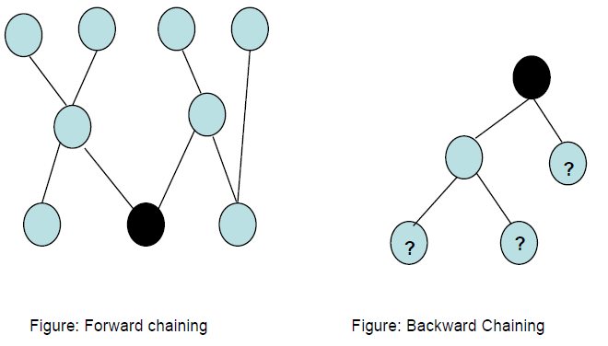
Forward vs. backward chaining

